Slide 1
Exploring Factors Affecting A Nation’s Social and Economic Standing Through Global Analysis
By: Kevin Huang
Notes:
Title.

Slide 2
Focus and Overview
Business Question:
What factors contribute to the differences in a country’s social and economic status between developed and developing countries?
Focus:
We want to find out what developing countries need in order to develop to a similar level to the current developed countries.
Notes:
I am a data analyst who will conduct analysis on WHO data to find insights and trends regarding factors that contribute to a nation’s social and economic well being. This includes medical, diseases, economic output, food and resources, and life expectancy. This analysis should put the focus on areas where improvement is needed for each country to reach a level of development where they are sustaining a cycle of continuous contribution and growth.
The audience consists of healthcare professionals, policymakers, researchers, and public health organization members. These audience members are interested in potential factors that determine a country’s social and economic well being and potential interventions to improve health and well being of citizens for their countries.

Slide 3
Dataset and Metrics
Dataset from World Health Organization (WHO) from 2000 to 2015 Does not include data from Greenland, South Korea, North Korea, Taiwan, Sudan, and Western Sahara)
Relevant Metrics:
Life Expectancy
GDP per Capita
Years of Schooling
Body Mass Index (BMI)
Diseases (HIV)
Notes:
We will do analysis on these metrics to see what differentiates a developed country from a developing country and from the analysis of the data we will be able to measure and find solutions to help improve a developing nation’s situation.

Slide 4
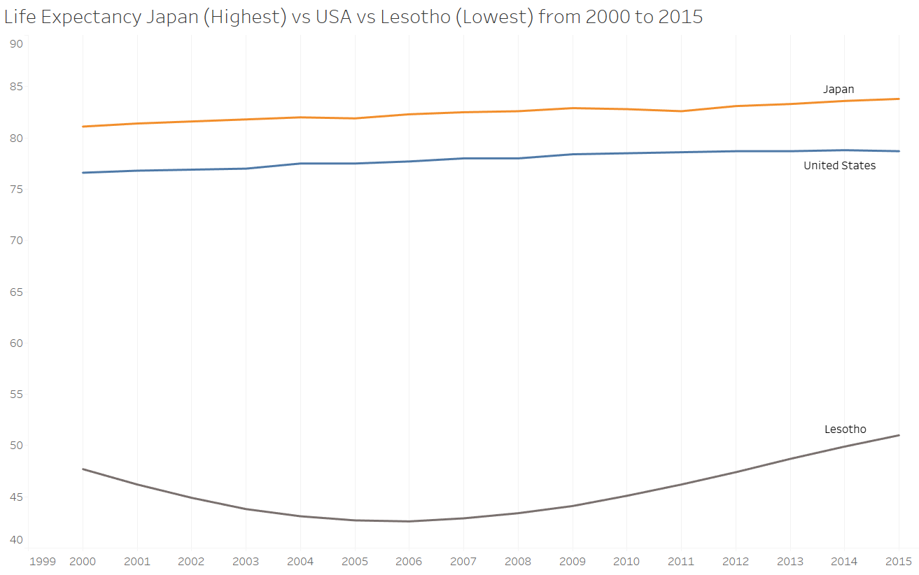
Life Expectancy
Developed countries such as the USA and Japan have higher life expectancies due to access to proper medical care, smaller poverty class, abundant resources, and a large economy.
83
78
32-year difference between Japan and Lesotho in 2015
Severe droughts and HIV/AIDS epidemic in Lesotho had LE dip into the 40s in the early 2000s
51
Notes:
Many factors contribute to a nation’s life expectancy, and it is one of the biggest factors that determine the status of a country. We can see the huge difference between Japan (highest LE) and Lesotho (lowest LE). We can also see natural disasters such as major droughts and spread of HIV and other diseases which severely impact life expectancy. While Japan who frequently have earthquakes can recover very quickly due to plentiful resources and economic power, Lesotho suffers greatly from droughts and diseases and have no way to recover without the help and intervention from the UN.

Slide 5
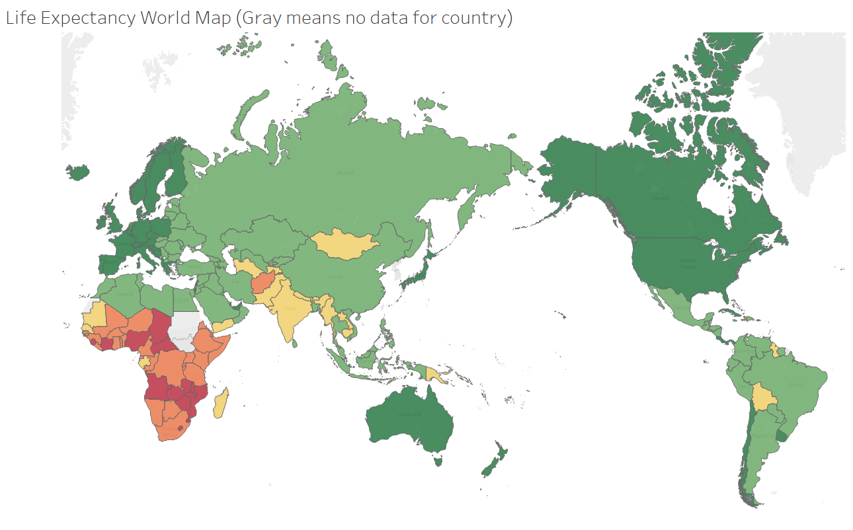

Life Expectancy Cont.
Developed regions such as North America, EU, Australia, and Japan have the highest life expectancies in the world.
Developing regions such as countries in Southern Asia, South America, and Africa have life expectancies around 12 years lower with Africa having the lowest at 20 years lower.
Average Life Expectancy for…
Developed country : 78.5 years
Developing country: 66.3 years
African continent: 57.9 years
Notes:
Life expectancy in countries in Africa are very low as they have most of the least developed countries in the world.

Slide 6
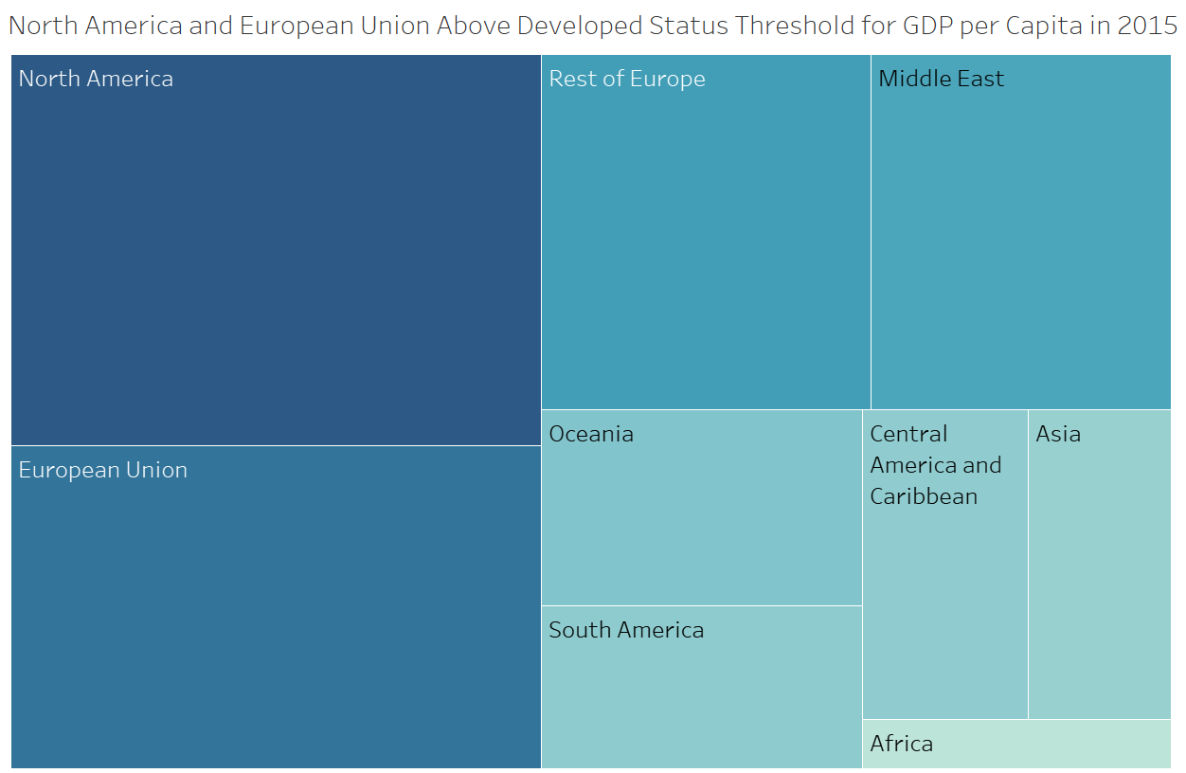
GDP per Capita
GDP per Capita is the economic output of a nation per person.
Region with highest GDP per Capita is North America closely followed by the European Union.
NA and EU combined made up for 45.7% of the global GDP per Capita in 2015 (excluding Greenland, South Korea, North Korea, Taiwan, Sudan, Western Sahara as there was no data available on them).
Notes:
The average GDP per Capita for North America was $36,659 followed by the European Union at $30,321. Nearly half of the global GDP is made up of just NA and EU. GDP per Capita is per person and is known as purchasing power parity. GDP is the total value of goods and services produced by a country. A high GDP does not necessarily mean a high GDP per Capita. In determining living standards for the average population, GDP per Capita is better because it measures per person instead of a country’s total output.

Slide 7
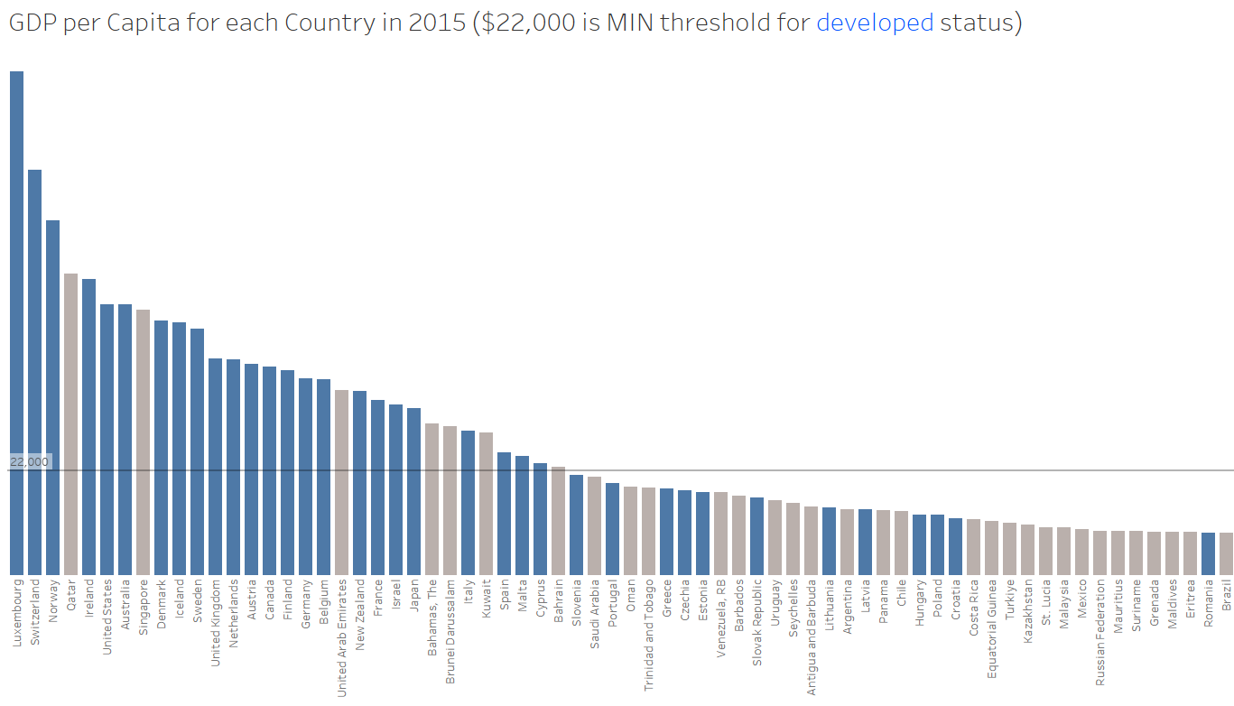
GDP per Capita Cont.
24 of the 31 countries ABOVE the minimum threshold are developed countries.
Country with the highest GDP per Capita is Luxembourg at $105,46.
The US is 6th place with $56,763 (roughly half of Luxembourg.
$22,000 MIN Threshold
Notes:
As you can see, not all developed countries pass the $22,000 threshold while some developing countries pass it. The threshold varies and some economists say it is at 12 or 15 thousand while some say it is 30 thousand. However, GDP per Capita is the economic output per person and countries like Romania have a high GDP (177.9 billion in 2015) but due to circumstances and uneven distribution the GDP per Capita is lower. This is the same with China where GDP is 11 trillion which is extremely high but GDP per Capita is low because of the uneven distribution of wealth. But in most cases, GDP per Capita is high among developed nations.

Slide 8

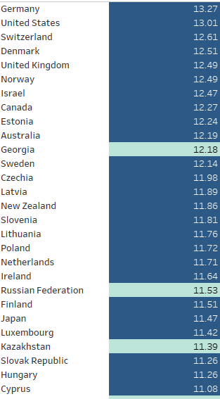
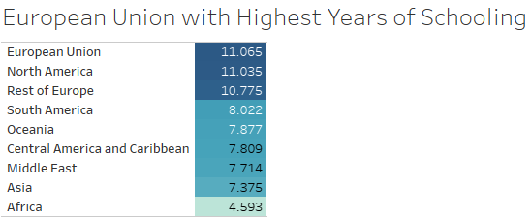
Years of Schooling
Developed countries have higher levels of education and more years of schooling creating highly capable individuals.
Developed countries average at 11.35 years of schooling while developing countries only sits at 6.66 years.
Developed countries average at 4.69 more years of schooling than developing countries.
EU, NA, and Rest of Europe take top 3 for years of schooling.
Notes:
Although most of the top years of schooling go to developed countries some countries such as Georgia and Russia are still considered developed even with years of schooling equivalent or higher than many developed countries. This is because there are many factors that determine whether a country is developed or not. Examples are differences in income distribution, poverty, political stability, governance, quality of education, and economic structure. Many developing countries have met some of the requirements of a developed country but are lacking in other areas leaving them at a developing state.

Slide 9
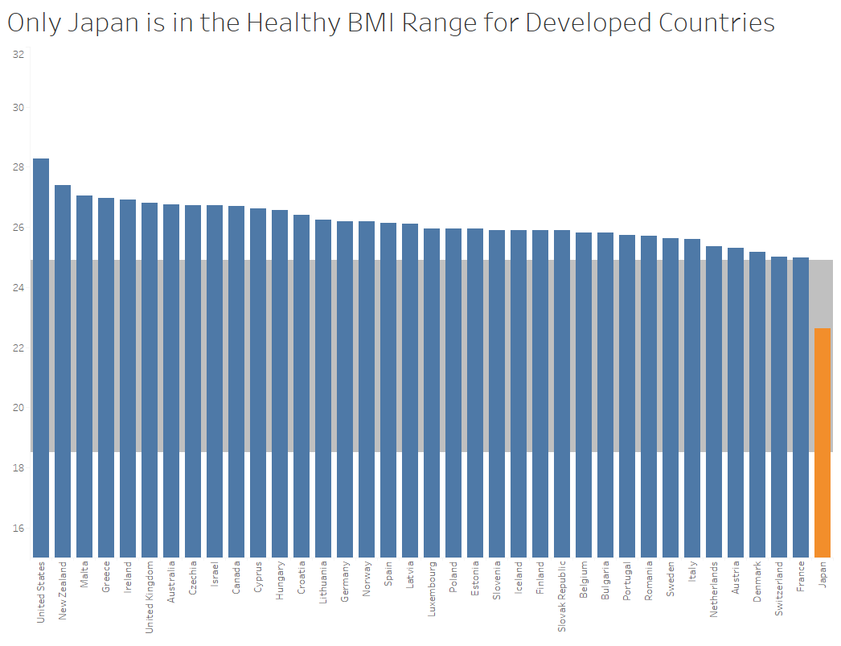
Body Mass Index (BMI)
Below 18.5 is underweight
18.5 to 24.9 is in the healthy range
24.9 to 29.9 is overweight
Above 29.9 is obese
Developed countries have a slightly higher BMI due to abundant access to food unlike developing countries who often struggle with a larger poverty class.
Developed countries average at a BMI of 26.08 while developing countries are at 24.76.
Notes:
The reason why the BMI difference is small is because there are many strict requirements as I mentioned in the previous slide. Furthermore, since the UN determines the status of each country there can be possible bias. For example, China who is second behind America in military and economic might was still listed as a developing country in 2015 by the UN.
Africa has an average BMI of 23.5 which is the lowest compared to all other regions.

Slide 10
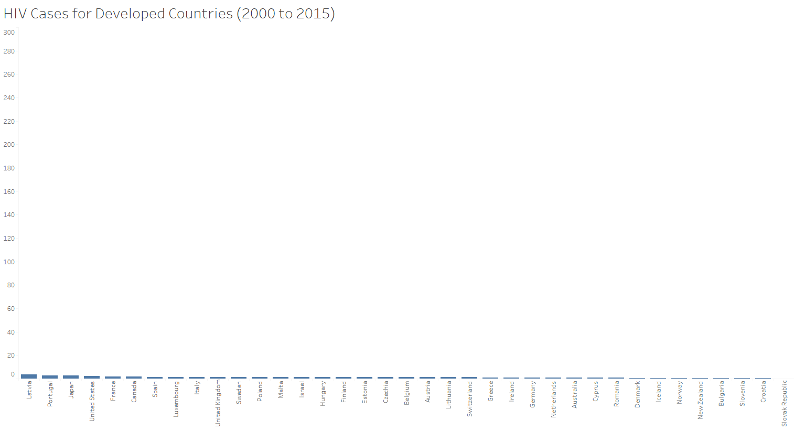
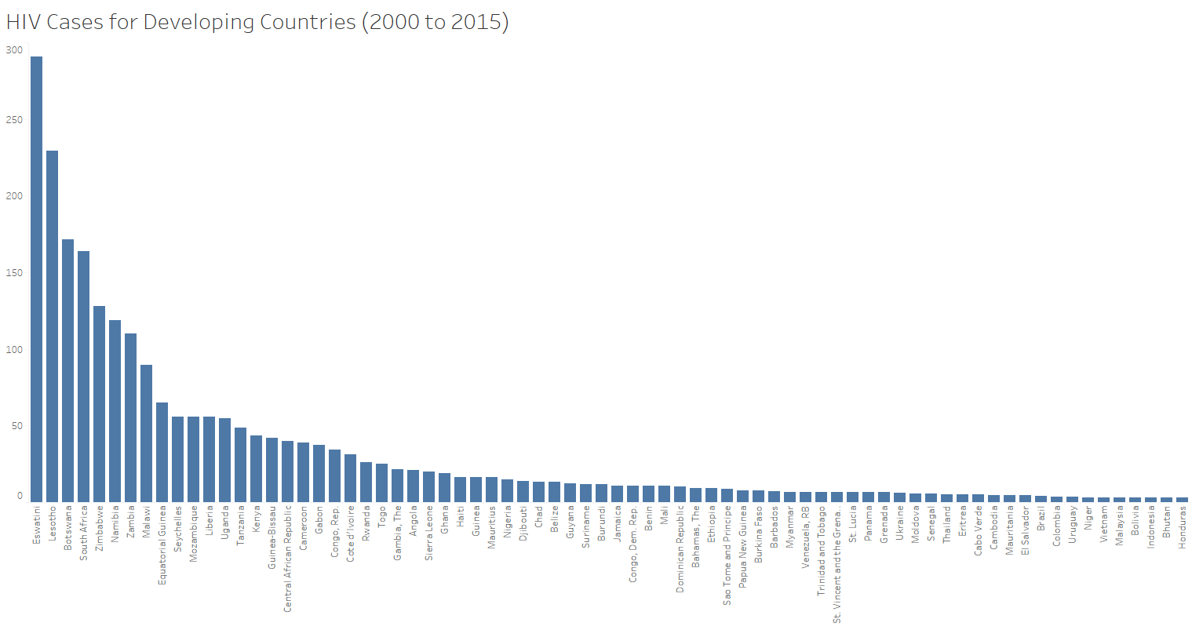
Diseases (HIV)
Developed countries have the medical education, capability, and technology to prevent and minimize the spread and effects of diseases such as HIV.
There are significantly LESS cases of HIV in DEVELOPED countries
Developed From 2000 to 2015 Developing
44 reported cases
3 cases per year
Of all recorded cases only 1.7% were from developed countries
2,516 reported cases
209 cases per year
Of all recorded cases over 98% were from developing countries
Notes:
We can see developing countries have a significantly higher number of HIV cases. This is because of the lack of education and medical advancements. Without investing in proper education, diseases will spread much faster and wider and with very few medical personnel and technologies the country will not be able to treat and stop the spread of diseases.

Slide 11

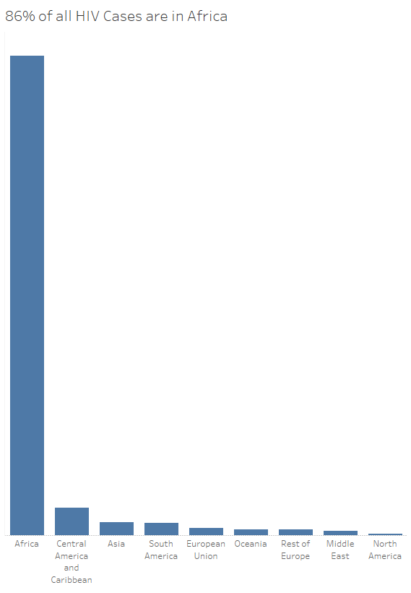
Diseases (HIV) Cont.
A significant portion of these cases come from the poorest of countries most of which are in Africa.
Africa
All the other regions combined (355 cases) don’t even come close to Africa (2,205 cases) in total cases of HIV from 2000 to 2015.
Notes:
Countries in Africa are the least developed globally and contribute to most of the HIV cases and other diseases. In order to reduce the spread of disease and illness. Resources must be spent to educate the population and to produce capable medical professionals.

Slide 12
Results
From this data and analysis, we learned:
Developed countries have (compared to developing countries):
Higher life expectancy (12.2 years higher)
Higher GDP per Capita (5.63 times higher or $29,837 higher in 2015)
More years of schooling (4.69 more years)
Slightly Higher Body Mass Index (1.32 higher)
Significantly Less cases of HIV (only 1.7% of total cases are from developed nations from 2000 to 2015)
Notes:
This data will show you from a statistical perspective of the gaps between developed and developing countries through these factors. From this data and analysis, we will be able to come up with reasonable actionable steps (provided in the next slide) to help solve the business question.

Slide 13
Recommendation
Actionable steps (where to allocate budget):
Allocate budget on education and educating the younger generations
Build an economic system that rewards hard work and contribution to the development of the nation
Establish a system of law that punishes crime and ill behavior
Utilize the country’s natural resources to gain economic power
Focus on farming and domestic food production as importing is expensive
Gather medical professionals and focus on research to fight diseases that shorten lifespan
Notes:
Establish a proper education system by building more schools and recruiting more teachers (teachers from overseas as well). A more knowledgeable workforce leads to more innovation and technological advancements. With proper and longer education, the country will solve its problems and can grow more rapidly.
Incorporating a capitalistic approach encourages hard work and contribution of citizens. This can increase economic output and will increase likelihood of development and trade with other countries.
Since crime is abundant in many developing countries, establishing law and order will contribute to less crime and enforce order.
Many developing countries have abundant natural resources as they have not yet learned how to extract them to use to further the economic power of their country.
To fight starvation, having a proper agricultural system will help eliminate lack of food.
Allocating resources to medicine and research can greatly increase lifespan of a country as diseases and illnesses will not be a major factor in early deaths.

Slide 14
Works Cited
“Assessing Your Weight.” Centers for Disease Control and Prevention, 3 June 2022, www.cdc.gov/healthyweight/assessing/index.html.
“Drought and HIV/AIDS Combine to Prolong Lesotho’s Misery, Say UN Agencies | UN News.” United Nations, news.un.org/en/story/2004/03/96062. Accessed 7 June 2023.
Goch, Lasha. “Life Expectancy (WHO) Fixed.” Kaggle, 30 Mar. 2023, www.kaggle.com/datasets/lashagoch/life-expectancy-who-updated.
Majaski, Christina. “What Is a Developed Economy? Definition, How It Works, HDI Index.” Investopedia, 19 Dec. 2022, www.investopedia.com/terms/d/developed-economy.asp#:~:text=Understanding%20a%20Developed%20Economy,-The%20most%20common&text=Some%20economists%20consider%20%2412%2C000%20to,is%20above%20%2425%2C000%20or%20%2430%2C000.
Team, The Investopedia. “GDP per Capita Defined: Applications and Highest per Country.” Edited by Thomas Brock, Investopedia, 30 May 2023, www.investopedia.com/terms/p/per-capita-gdp.asp#:~:text=GDP%20per%20capita%20measures%20the,per%20person%20in%20a%20nation.
Notes:
Sources used.

Slide 15
Thank you
and have a great day!
Notes:
The end.

